Slide 1
An Efficient Language Learning Method-VR Vocabulary Crossword Puzzle Game
Check Point 1
CS567-Project
Members: Zihui Li, Xiongtian Yi, Jacinda Li

Slide 2
Introduction
VR Crossword Game

Slide 3
Introduction/Motivation
For this game, we mainly use Unity, Unity Team Oculus Quest VR HMD, XR Interaction Toolkit, XR plugin Management, and Windows systems.
Vocabulary Crossword Puzzle Game.
Participants will use this game to study English without stress.

Slide 4
Current state
VR Crossword Game

Slide 5
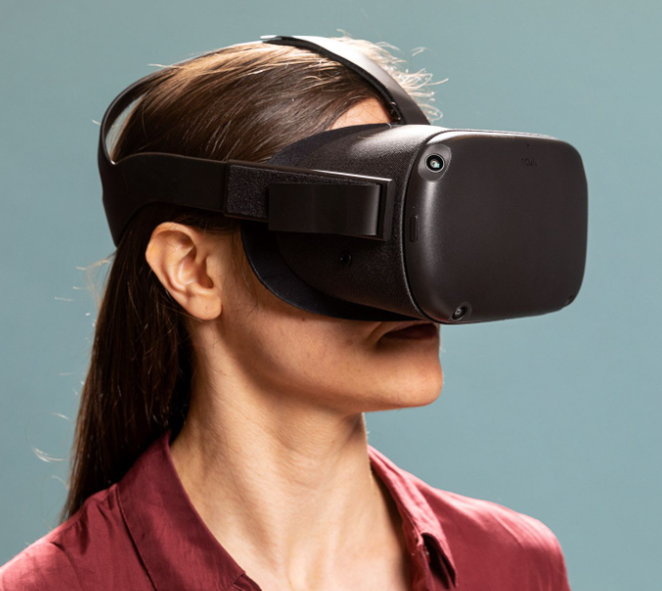
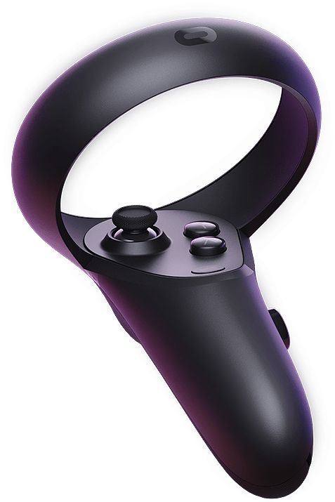
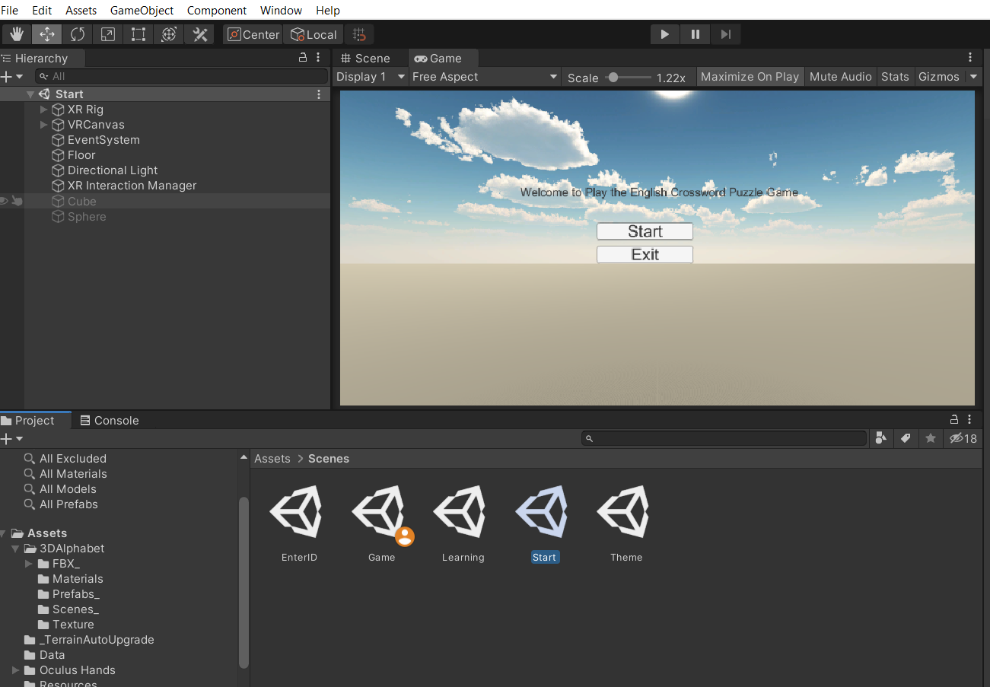
Tools
VR Headset
VR controller with two hands
Unity interface

Slide 6





The completed part -- Scenes in Unity
Start .unity
Join this experiment
Enter ID .unity
Enter the Participants ID
Theme .unity
Choose the theme
Learning .unity
Learning the English words
Game .unity
Play the game

Slide 7
Video about the code
Video is included as the YouTube link README.md file. Please refer to the github repository.

Slide 8
Video of Project Running

Slide 9
Next steps
Complete the writing of different word theme
Complete the use of the chessboard
Improve the interactivity of the learning vocabulary interface
Improve page layout
….

Slide 10
Thank You

